Slide 1
SRP Solar Heater
Carl Aaker
Ahmad Abuouf
Wyatt Bain
Tatum Begay
Alonzo Bizahaloni
Brandon Dunn
Taylor McCormick
William Senseman

Slide 2

Project Description
We are examining the effectiveness of pairing Phase Change Material (PCM) with solar air heaters to provide warm air to those who are off the grid on the Navajo Nation
Salt River Project (SRP) is our sponsor for this project, the goal is to reduce or eliminate the coal, wood, or propane heaters currently in use which will help reduce emissions while also providing warm, healthy, and safe environment for those who may use it

Slide 3
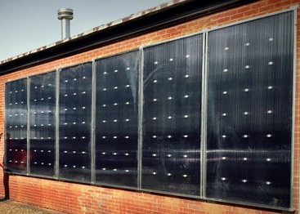
Background
We are given a SolarThermix STX 7000 which is a solar air heater panel which we will be combining with PCM which no one has done yet
One current use of the solar air heater is in the ROTC building which is in the middle of NAU campus.
Phase change material is currently used in the north campus Blome building in order to aid in insulation and provide heat to the building throughout the night.

Slide 4
Research
PCM melts or thaws to reach a target temperature while using the process of phase change
Solar air heater has solar panels to operate the fan which pushes the heat into the house which is collected by absorbing the sunlight
We have researched the Navajo Nation which takes up portions of Arizona, Colorado, New Mexico, and Utah and the modern Hogan.

Slide 5
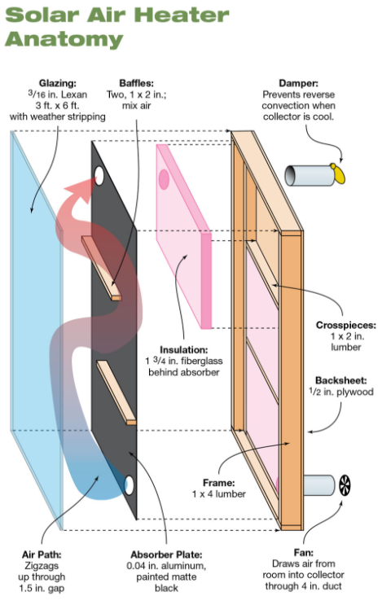
Benchmark
Most existing designs are DIY projects similar to the concept shown here but there are some on the market that cost as much as $3,500
They all have different ways to capture the heat from solar panels to running a black pipe through the panel by absorption
Then most run the heat back through the house with a small fan at the bottom of the panel

Slide 6
Design Requirements
Must be able to heat a hogan or Navajo home off the grid
Solar heater for a modern hogan
Solar heater is to be mounted outside the hogan during the day
PCM material goes inside the house at night after being heated
Must be able to heat home in harsh weather conditions
  Snow
  Rain
  Wind

Slide 7
Consumer Requirements
Must use SolarThermiX solar heater and PCM
Solar heater must be able to generate energy during inclement weather or cloudy days
Solar heater must be able to heat the hogan throught the night
Solar heater must to easy to operate and maintain

Slide 8
Engineering Requirements
Phase change material must retain temperature between 75° to 80° Fahrenheit when removed from the solar air heater
Solar heater and phase change material must be able to have a lifetime expectancy of at least 10 years
Must be able to heat phase change material a minimum of 8 hours during the day
Solar Air Heater generates 7.9 MJ/hr by solar energy.

Slide 9

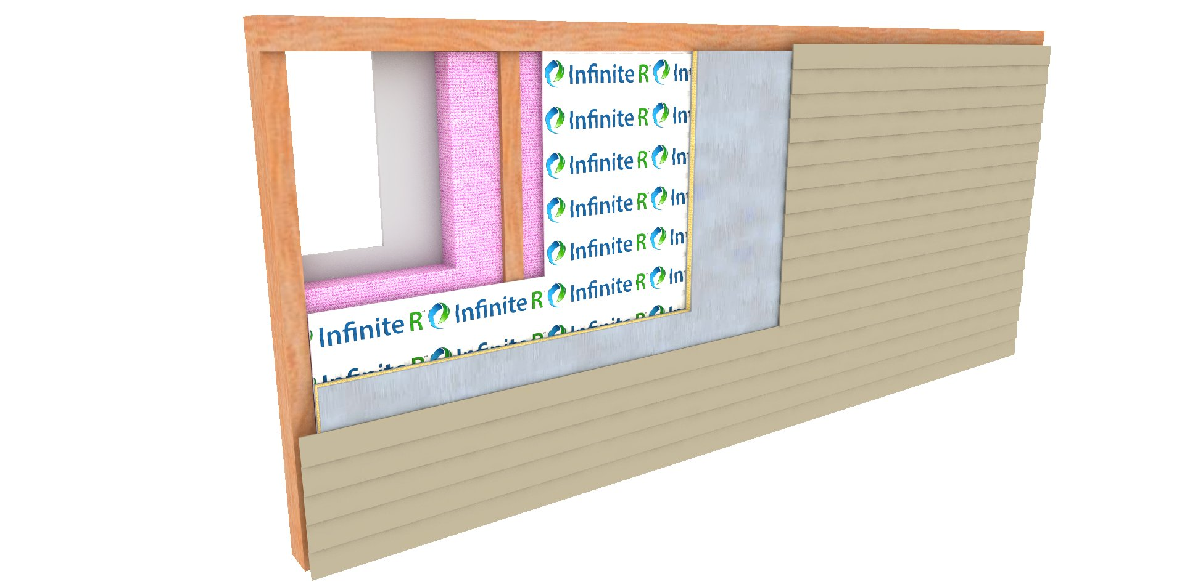
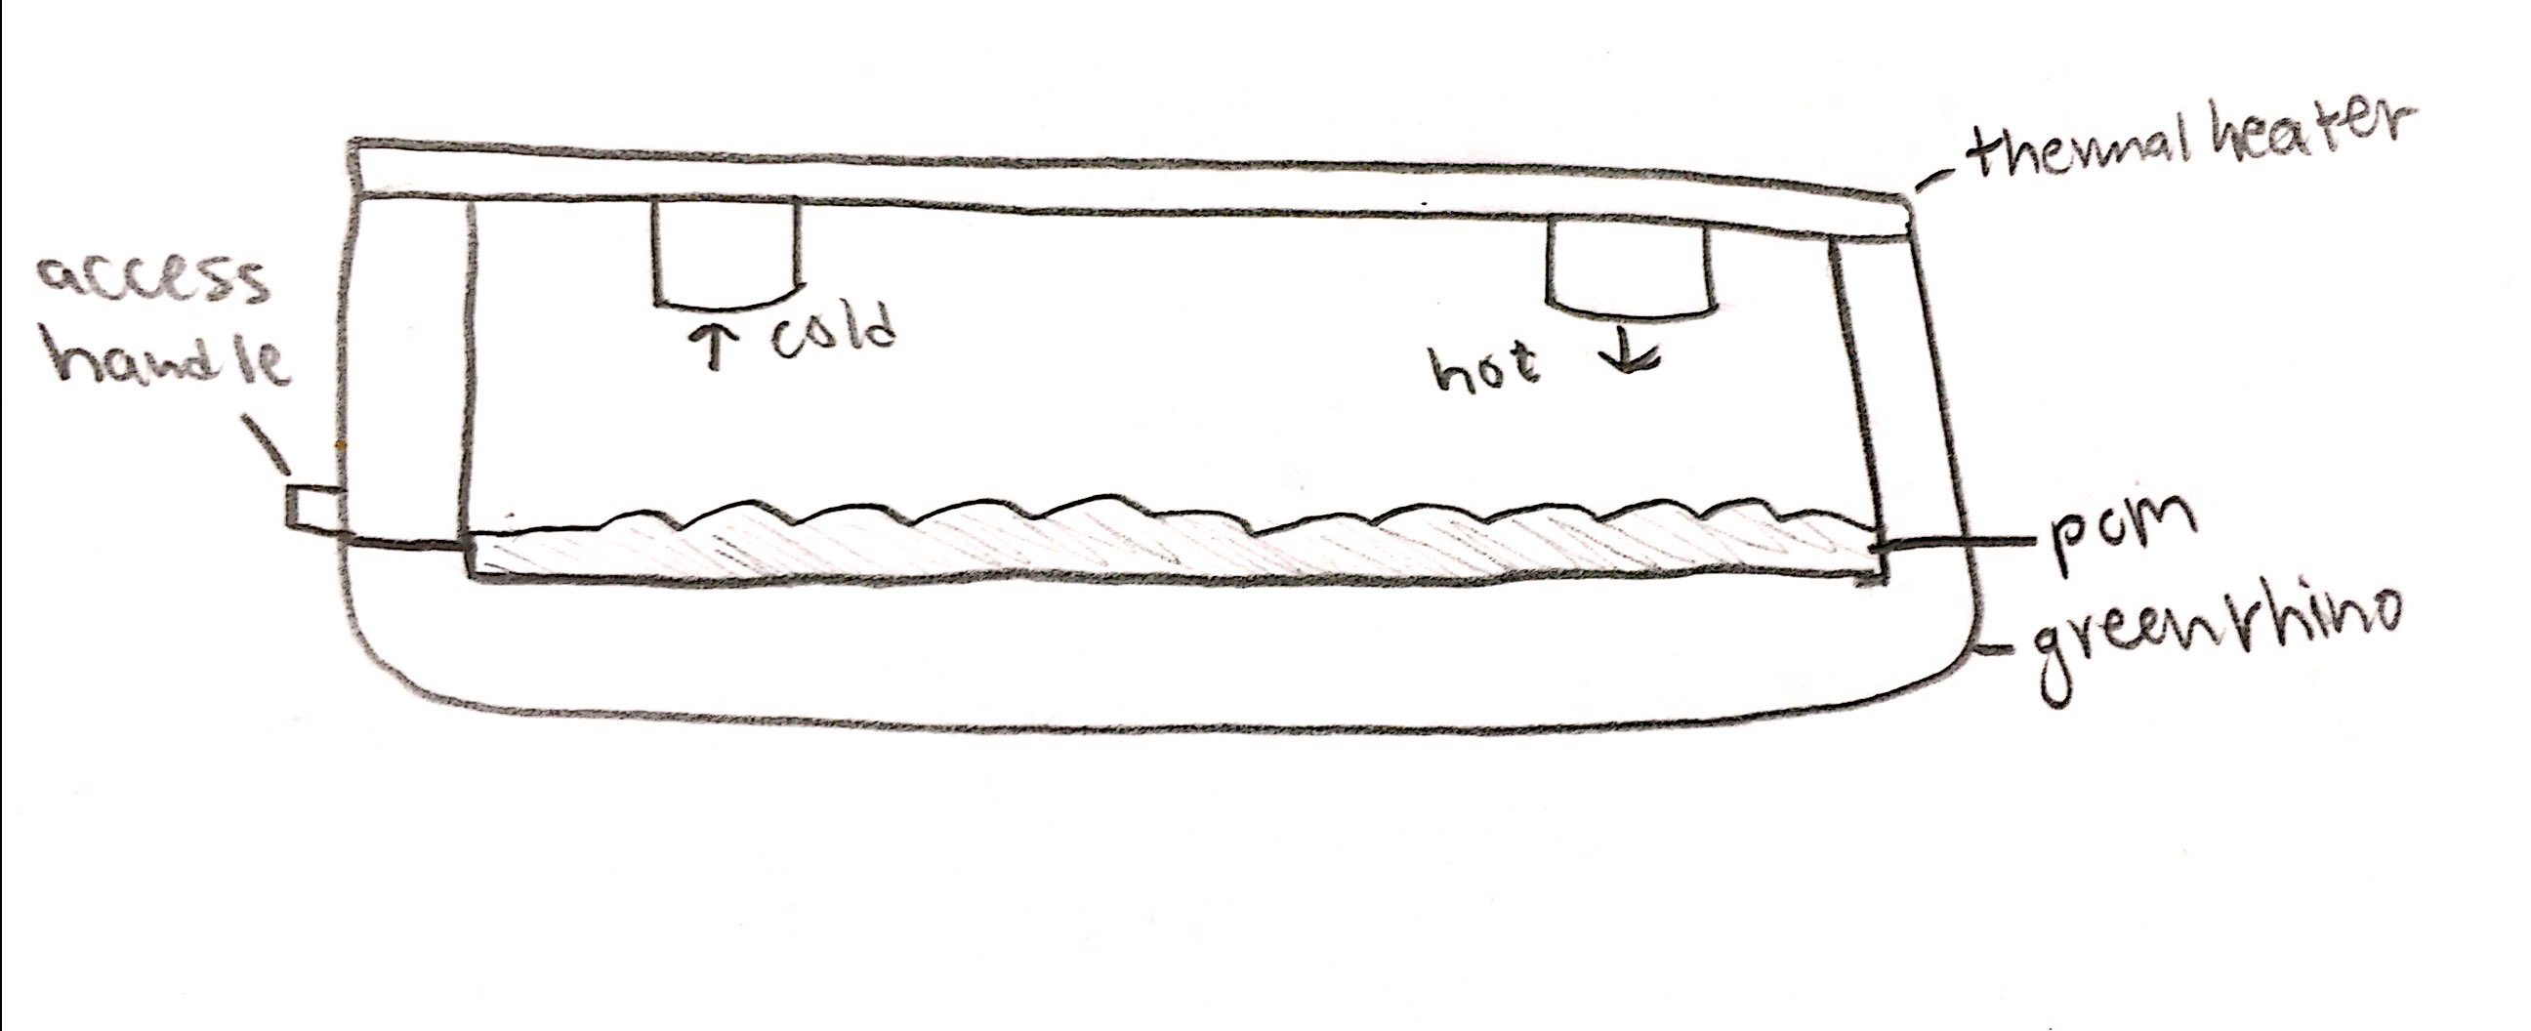
Designs Considered

Slide 10
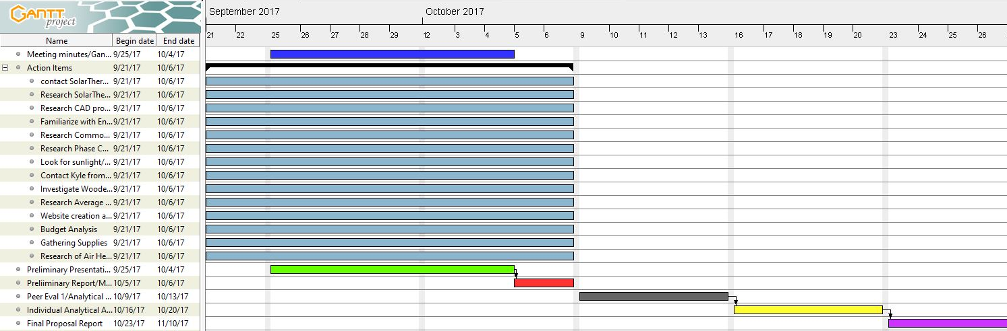
Schedule
The team is currently on schedule with all assigned tasks and action items.

Slide 11
Budget
The cost
Solar Air Heater: $1,500
PCM: $3 per square foot

Slide 12
References
[1] Daly, Michael. “Solar Air Heater.” SolarThermiX, www.solarthermix.net/heat Date accessed:September 21, 2017.
[2] Daly, Michael. “Phase Change Material.” SolarThermiX, www.solarthermix.net/phase-change/ Date accessed:September 21, 2017.
[3] “Salt River Project.” SRP: Salt River Project Power and Water, www.srpnet.com/default.aspx Date accessed:September 19, 2017.
[4] Stephen Hren “Solar Air Heater Anatomy.”, www.homepower.com/sites/default/files/articles/ajax/docs/Heater_Anatomy.jpg Date accessed: September 18, 2017.
[5] “Green Rhino Building Systems.” GR Building Systems LLC, grbuildingsystems.com/ Date accessed: September 18, 2017.

